Slide 1
Gravitational Field Strength “g” (Simplified)

Slide 2
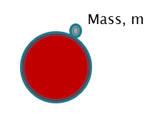

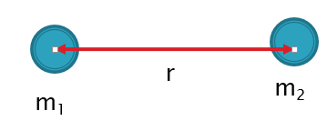
We have now been introduced to TWO equations for calculating the force of gravity:
Applies for object mass m, on Earth’s surface.
(g = 9.80 N/kg)
Applies for any two objects (m₁, m₂) separated by distance r!
G= 6.67 x 10⁻¹¹ Nm²/kg²

Slide 3



We can use both equations to find the force of gravity acting on a cat (or any object) on the surface of the Earth:
Cat mass= m
Earth mass = M_{Earth}
Radius between cat and Earth= r_{Earth}
r_{Earth}
But these expressions must be the SAME!!
F_{g} = F_{G}

Slide 4


Equating the expressions:
The mass of the cat cancels out!!
This gives us an expression for calculating the gravitational field strength of the Earth!

Slide 5

We can use this equation to find the gravitational field strength of any large astronomical object!
Example 1: Mars has a mass of 6.42 x 10 ²³ kg and radius of 3.40 x 10 ⁶ m. Find the gravitational field strength on the surface of Mars.

Slide 6
We can use this equation to find the gravitational field strength of any large astronomical object!
Example 1: Mars has a mass of 6.42 x 10 ²³ kg and radius of 3.40 x 10 ⁶ m. Find the gravitational field strength on the surface of Mars.
Ans: 3.70 N/kg

Slide 7

Example 2:
A cat of mass 5Kg is sitting on the surface of Mars. Find the force of gravity on the cat.
Mass of Mars: 6.42 x 10²³ kg Radius of Mars= 3.40 x 10 ⁶ m
r_{mars}

Slide 8
Example 2:
A cat of mass 5Kg is sitting on the surface of Mars. Find the force of gravity on the cat.
Mass of Mars: 6.42 x 10²³ kg Radius of Mars= 3.40 x 10 ⁶ m
Hint: Once g is known at a location, we can use F_{g}=mg to find the gravitational force on any object at that location!
r_{mars}

Slide 9
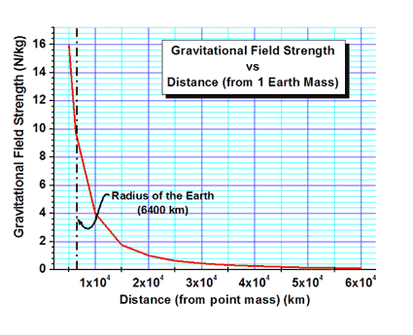
Variation of field strength with distance from the Planet’s centre:
As r increases, g rapidly decreases!
Inverse square
Relationship!

Slide 10
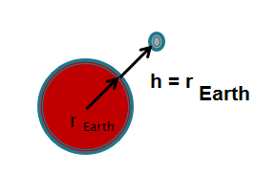
We can use this equation to find the gravitational field strength at a point above the planet’s surface.
Example 3a: A satellite is orbiting at one Earth radius above the surface of the Earth. Find the gravitational field strength at that point.
Solution: Draw a picture!
m _{Earth}= 5.97 x 10 ²⁴ kg
r= r_{Earth} + h
= r_{Earth} + r_{Earth}
= 2 (6.38 x 10⁶ m)
=1.276 x 10 ⁷ m
= (6.67 x 10 ⁻¹¹ Nm²/kg²)(5.97 x 10 ²⁴ kg)
(1.276 x 10 ⁷ m)²
= 2.45 N/kg

Slide 11
Example 3b. Continued Using the gravitational field at the height, find the gravitational force acting on the satellite due to the Earth. Assume that the mass of the satellite is 500 kg.
Hint: Once g is known at that location, we can use F_{g}=mg to find the gravitational force on any object at that point!
Solution:
F_{g} = mg
m =500.0 kg
= (500.0 kg) (2.45 N/kg)
g =2.45 N/ kg
= 1.22 x 10 ³ N
F_{g} = ?

